Slide 1
PolyOrganoSiloxane, Synthesis and Application
From Raw Material To Final Products
content
Introduction.
The Element Silicon.
The Structure of Silicones.
Silicone Applications.
Widad. salih

Slide 2
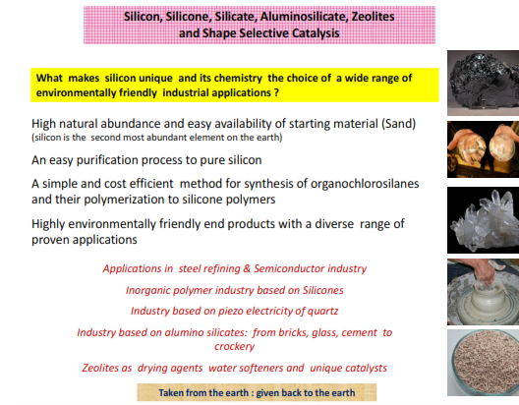
from raw material to tHe
ProduCt world
Widad. salih

Slide 3
Widad. salih

Slide 4
Widad. salih
Widad. salih

Slide 5
Raw Material of chlorosilanes
the direct process of Rochow2 and using silicon metal obtained from the reduction of sand at high temperature:
SiO2 + 2 C
Si + 2 CO
and methyl chloride obtained by condensation of methanol with hydrochloric acid:
CH3OH + HCl
CH3Cl + H2O
Synthesis of chlorosilanes
The reaction giving chlorosilanes takes place in a fluidised bed of silicon metal powder in which flows a stream of
methylchloride, usually at temperatures of 250 to 350°C and at pressures of 1 to 5 bars. A mixture of different silanes are obtained :
Widad. salih

Slide 6
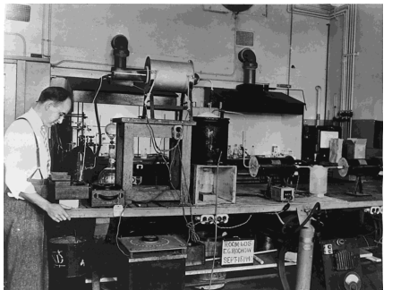
Ethyl- and phenylchlorosilanes can also be obtained through similar reactions to the direct process described above.
MeSiCl3 + C6H5MgBr
Me(C6H5)SiCl2 + MgClBr
It is also possible to replace the chlorine groups by alcoholysis
-SiCl + ROH
SiOR + HCl
Rochow with his more elaborate Direct Synthesis Apparatus in the GE Reseach Laboratory
Widad. salih

Slide 7
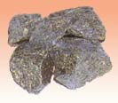
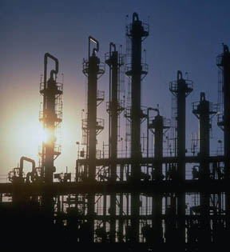
Process Chemistry of Methyl Train
Me₂SiCl₂ 70C
MeHSiCl₂
Me₃SiCl 58C
H₂O
Me2 Hydro
SiH fluid
MeSiCl3 66C
Chlorosilane
Mix
Waste &
Recovery
Si
MeCl
Copper Catalysts
Widad. salih

Slide 8
Widad. salih

Slide 9
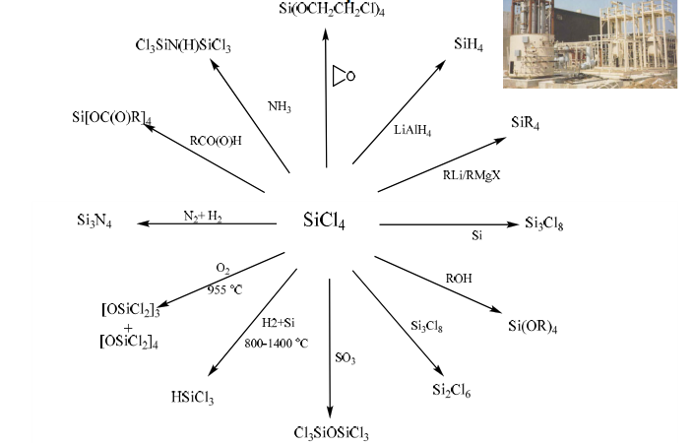
Silicon Tetrachloride : Auseful Precurser
Widad. salih

Slide 10
Silicone polymers
. Silicone polymers are obtained by a three-step synthesis:
• Chlorosilane synthesis
• Chlorosilane hydrolysis
• Polymerisation and polycondensation
Despite the Fact that Silicon and Carbon are both Group IV elements their chemistry is very different
Unique flexibility of Si-O bond
Si-O-Si C-C-C C-O-C units bond length 1.63 1.54 1.42 angstroms bond angle 130 112 111 degree bond energy 106 83 86 Kcal/mol bond barrier 0.2 3.6 2.7 Kcal/mol
Widad. salih

Slide 11
Key Point: Siloxane (Si-O-Si) polymers are stronger than carbon polymers, yet the polymer chains are more open and flexible
Siloxane Physical Properties
Very low glass transition temperature (Tg = -120 °C)
high molecular weights but not a solid
Ability to spread out on a wide variety of substrates
silky, smooth, non-tacky, aesthetic enhancing
flowability and film forming
Lowest surface shear viscosity and low surface tension
lubricating, antifoaming, waterproofing, release properties
High gas permeability
Excellent dielectric properties
Very good thermo-oxidative stability
good chemical inertness and temperature resistance
Widad. salih

Slide 12
Silicone Family Tree
Elastomers
Fluids & Emulsions
Silicone
Resins
Silanes
Dimethyl
Compounds
Silicone Polyethers
Organo-Silicones
Volatile Methyl
Siloxanes
Amino Silicones
Si
Widad. salih

Slide 13
Silicone Nomenclature Shorthand
Precursor Silanol Siloxane Structure Short hand
Me Me
Cl-Si-Cl HO-Si-OH Linear Structures D unit
Me Me
Me Me
Me-Si-Cl Me-Si-OH End-cap group M unit
Me Me
Me Me
Cl-Si-Cl HO-Si-OH Branched Structures T unit
Cl OH
Cl OH
Cl-Si-Cl HO-Si-OH Silica Core Q unit
Cl OH
Me Me Me Me Me
Me-Si-O-Si-O-Si-O-Si-O-Si-Me
Me Me Me Me Me

Slide 15
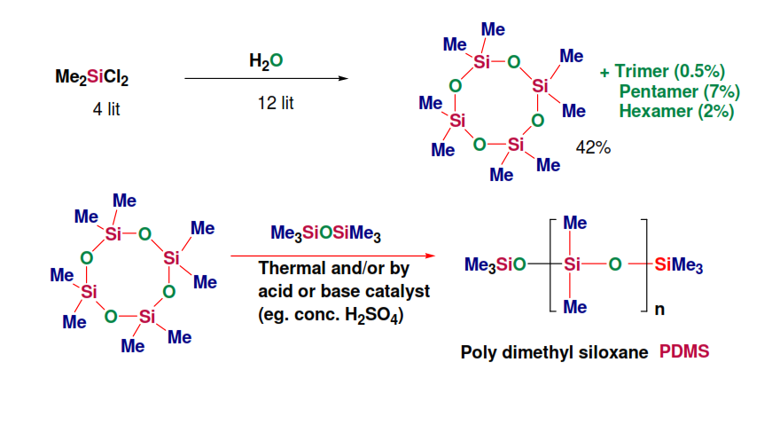
Synthesis Of Silicone Fluide

Slide 16
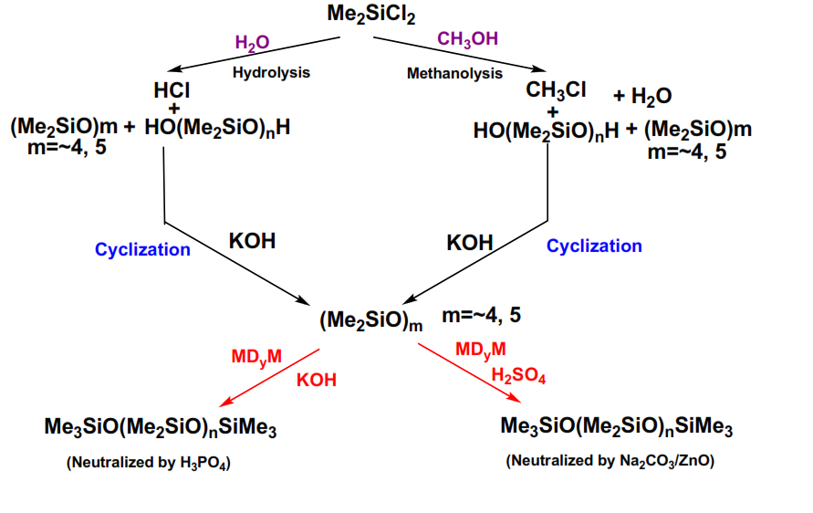
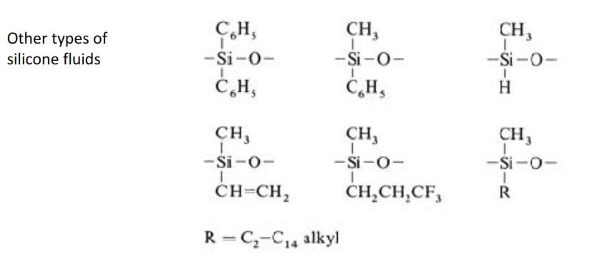
Industial Synthesis of Silicone Fluide

Slide 17
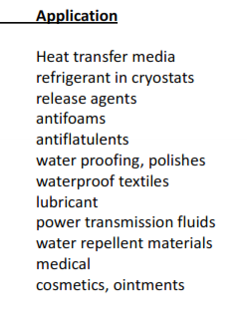
Silicone fluids are distinguished from common organic fluids by a number of unique properties :
1- Good thermal stability (150 -250 C
2- Good low –temperature performance (< -70 C )
3- Strong hydrophobicity
4- Excellent release property
5- Pronounced surface activity
6- Good dielectric properties
7- very good damping material
8- Good radiation resistance
9-High solubility of gases
10- Physiological inertness

